Slide 1
American Driving Survey:
2014 — 2015
September 2016

Slide 2
Report by AAA Foundation for Traffic Safety & The Urban Institute
Released in September 2016

Slide 3
Overview
The American Driving Survey was launched in May 2013, to collect information on driving habits of the American public
Report on first year of data was published in 2015.
This report presents results on the driving of the American public in 2014 and 2015

Slide 4
Methods
Data collected from telephone surveys of drivers ages 16+ in a random sample of US households
Drivers reported detailed info on all driving done in 24-hr period on the day before the interview
Interviews were conducted every day of the year, by landline & cell phone, in English & Spanish
Drivers ages 16-19, ages 75+, and those who drive more frequently were oversampled
Data were weighted to produce nationally representative estimates

Slide 5
Drivers and Vehicles per Household
Household-level data:
Average number of drivers: 1.8
Average number of vehicles: 2.1
58% of households have same number of vehicles as drivers
28% have more vehicles than drivers
14% have fewer vehicles than drivers
Data: Sample of 7,576 U.S. households

Slide 6
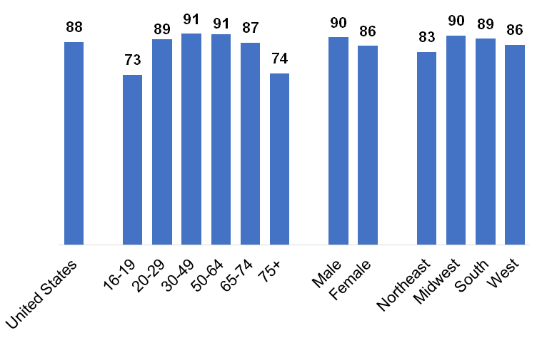
Percent of the population that drives
Data: 15,469 people aged 16+ in sample of 7,576 U.S. households

Slide 7
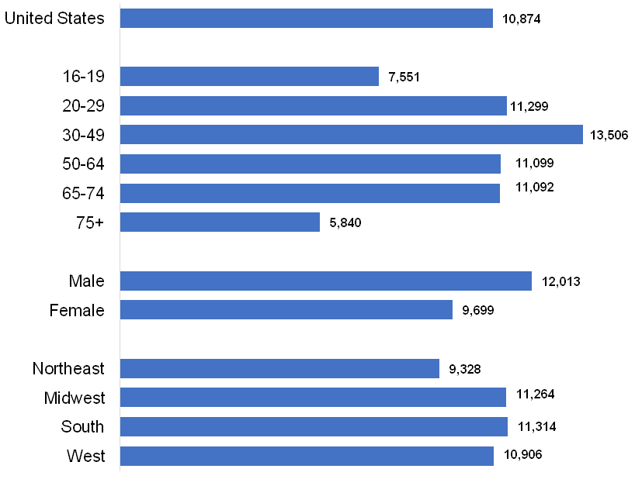
Annual average miles driven
Data: Sample of 5,774 drivers ages 16+

Slide 8
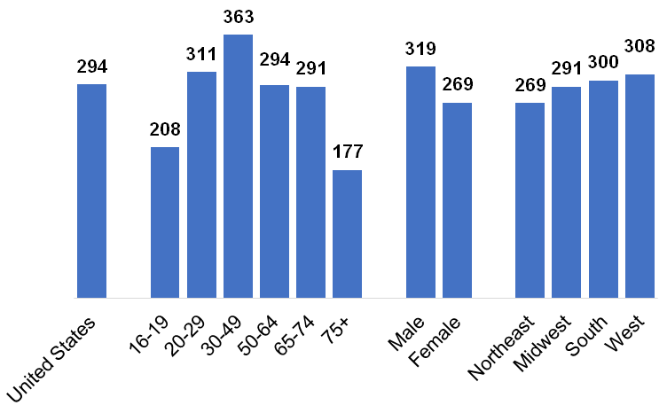
Annual average hours spent driving
Data: Sample of 5,774 drivers ages 16+

Slide 9
Driving with Passengers vs. Alone
66.2% of trips alone, 33.8% with passengers
Women were significantly more likely than men to have passengers on any given trip
While drivers who lived in cities, towns, and in the country had similar proportions of trips with passengers, drivers in the country drove a greater proportion of total miles alone
Driving trips on weekends were much more likely to include passengers than trips on weekdays
Data: Sample of 5,774 drivers ages 16+

Slide 10
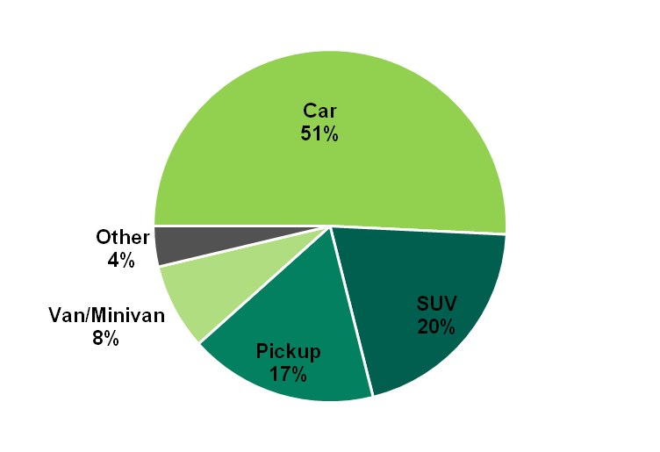
Percent of Total Miles Driven by Vehicle Type
Data: Sample of 5,774 drivers ages 16+

Slide 11
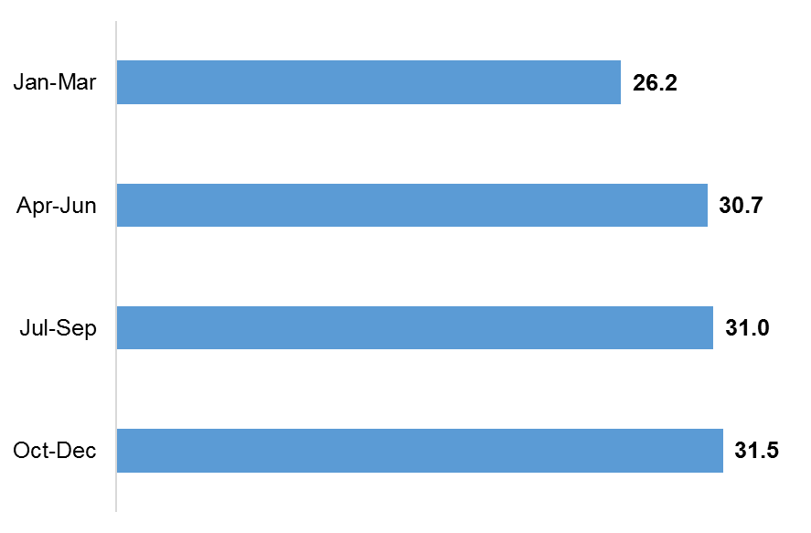
Average Daily Miles Driven by Quarter
Data: sample of 5,774 drivers ages 16+

Slide 12
Changes from 2014 to 2015
Population aged 16+: +2.5 million (1.0%)
Proportion that drives: +0.5% → total drivers: +3.3 million (1.5%)
Average miles per driver: +0.2 miles (0.8%)
→ total miles driven: +56 billion (2.4%)
Data: Population from US Census Bureau; % that drives from 15,469 people in sample of 7,576 households; average miles per driver from sample of 5,774 drivers

