Slide 1

Driving Under the Influence of Alcohol and Marijuana: Beliefs and Behaviors, United States, 2013-2015
May 2016

Slide 2
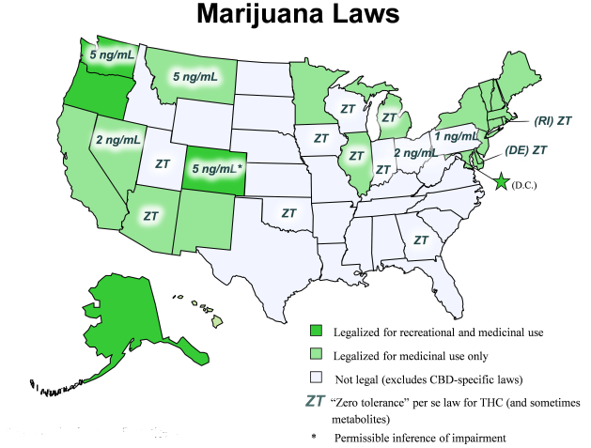
The Situation
• Increasing numbers of states have legalized or are considering legalizing medical and/or recreational marijuana use, bringing attention to the issue of marijuana and other drug and alcohol impaired driving among traffic safety professionals

Slide 3
Objective
• The purpose of this study was to:
  provide estimates of the prevalence of self-reported use and driving under the influence of alcohol and marijuana, and related perceptions and beliefs among drivers 18 and older in the United States
  present an analysis of changes in these behaviors between 2013 and 2015

Slide 4
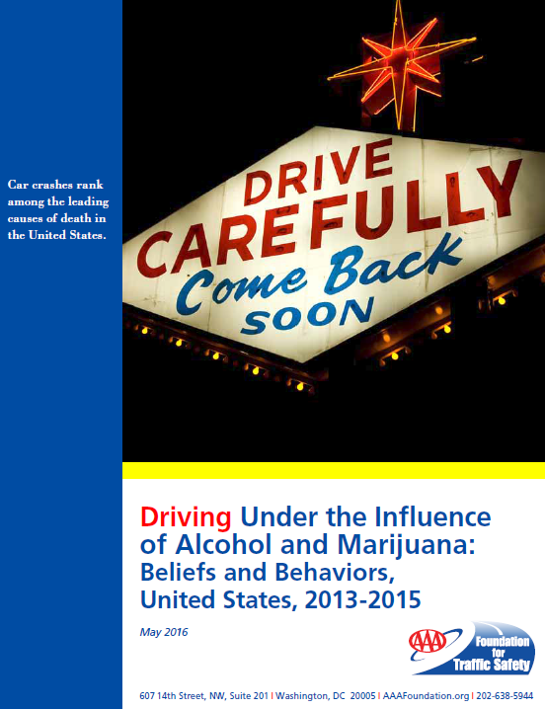
AAA Foundation for Traffic Safety
Released in May 2016

Slide 5
Overview
The data analyzed were collected as part of the AAA Foundation’s Traffic Safety Culture Index (TSCI) surveys. The TSCI is an annual survey administered online to a sample of U.S. residents enrolled in a research panel recruited using random-digit dial and address-based sampling methods and designed to be representative of the United States population
  For this study, 6,612 respondents were included from surveys conducted in 2013-2015

Slide 6
Overview
The TSCI includes a core series of questions pertaining to the respondent’s attitudes about traffic safety, perceptions of social norms, and self-reported driving behavior. Relevant to the current study, the core survey includes questions regarding:
  frequency of drinking alcohol and using marijuana
  driving under the influence of alcohol and/or marijuana
  related beliefs and perceptions, and support for countermeasures designed to address alcohol- and marijuana-involved driving

Slide 7
Overview
Example question:
“In the past year, how often have you driven…”
  “when you thought your alcohol level might have been
close to or possibly over the legal limit?”
  “within 1 hour of using marijuana?”
  “within one hour of consuming both marijuana and alcohol, even if you
weren’t drunk?”

Slide 8
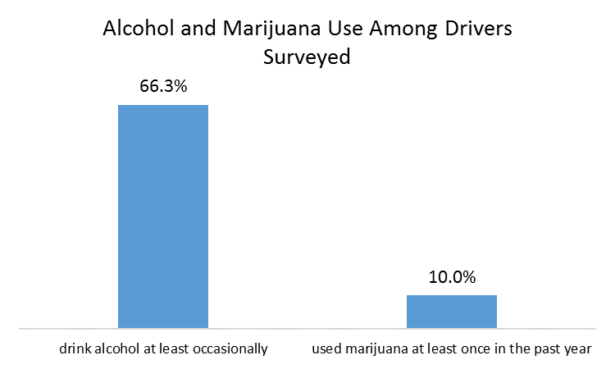
Key Findings
Alcohol and marijuana use
Nearly two in three drivers reported that they drink alcohol at least occasionally; this percentage was relatively stable over the study period. One in ten drivers reported having used marijuana at least once in the past year; there was some year-to-year fluctuation in this percentage, but no evidence of a trend

Slide 9
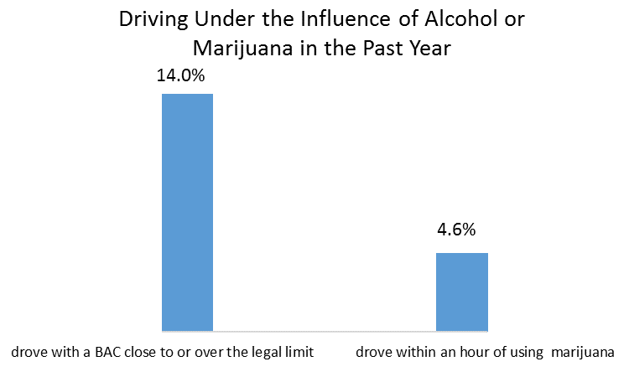
Key Findings

Slide 10
Key Findings
Driving Under the Influence of Alcohol and/or Marijuana
Drivers who were aged 25-39, male, and those who reported using marijuana were the most likely to report having driven with a BAC close to or over the legal limit. Drivers who were aged 18-24, male, and those who lived in the Midwest were the most likely to report having driven within an hour of using marijuana

Slide 11
Key Findings
Knowledge of per se laws for marijuana
Awareness of per se DUI laws for marijuana was low
While self-reported driving after using marijuana was not associated with actual state per se laws regarding marijuana and driving, it was significantly associated with what
people thought their states’ laws were

Slide 12
Key Findings
Beliefs about effect of marijuana on driving
Drivers are divided with regard to their perceptions of the effect of using marijuana an hour prior to driving on one’s risk of causing a crash: 58.3 percent believe this risk is increased, 6.2 percent believe it is not affected, 3.6 percent believe it is decreased, and 31.8 percent indicated that they do not know how using marijuana an hour before driving affects crash risk
Drivers who reported using marijuana, and those who reported driving within an hour of use in the past year were less likely to believe that using marijuana increases crash risk, and more likely to believe that such use does not affect or decreases
crash risk

Slide 13
Key Findings
Acceptance of impaired driving
Virtually all drivers feel it is unacceptable to drive when one may have had too much to drink and after using both marijuana and alcohol; nearly one in ten feels it is acceptable to drive one hour after using marijuana

Slide 14
Key Findings
Support for impaired driving countermeasures
A majority of drivers support reducing the BAC limit from 0.08 to 0.05 grams per deciliter (63.6%) and support having a per se law for marijuana (82.9%)

