Slide 1

Prevalence of Marijuana Involvement in Fatal Crashes: Washington 2010- 2014
May 2016

Slide 2
The Situation
• In November 2012, the citizens of the state of Washington approved by popular vote ballot Initiative 502, which allows adults aged 21 years and older to possess up to 1 ounce of marijuana for personal use
  The new law became effective on December 6, 2012

Slide 3
The Situation
  Not much is known about the prevalence of driving after using marijuana or the prevalence of recent marijuana use among drivers involved in crashes primarily due to data limitations
  In January 2016, the Washington Traffic Safety Commission (WTSC) made available the results of toxicology tests for THC performed on drivers involved in fatal crashes in the state of Washington, and appended these new data to their database of all drivers involved in fatal crashes statewide

Slide 4
The Situation
  This study uses these new data from the WTSC to estimate the proportion of drivers in fatal crashes in the state of Washington who had a detectable concentration of THC in their blood at the time of the crash and to investigate whether that proportion changed after Washington Initiative 502 took effect

Slide 5
Objective
• The purpose of this study was to quantify the prevalence of marijuana involvement in fatal crashes in the state of Washington in years 2010 – 2014 and to investigate whether the prevalence changed after Washington Initiative 502, which legalized recreational use of marijuana for adults aged 21 years and older, took effect on December 6, 2012

Slide 6
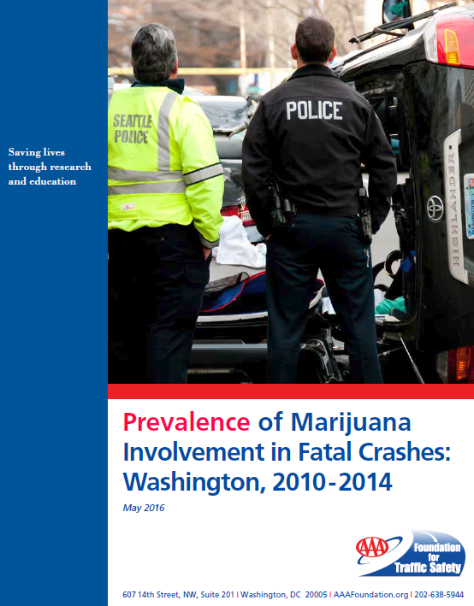
AAA Foundation for Traffic Safety
Released in May 2016

Slide 7
Overview
The data examined were obtained from the WTSC and comprised a census of all motor vehicle crashes that occurred on public roads in the state of Washington and resulted in a death within 30 days
Examined the presence and concentration of delta-9-tetrahydrocannabinol (hereafter THC), the main psychoactive chemical in marijuana, in the blood toxicological test results of drivers involved in fatal crashes
THC presence and concentration in the subset of drivers whose blood was not tested or whose test results were unavailable were estimated using the method of multiple imputation, a statistical method used to replace missing THC values with values from other similar cases, taking into account the correlation of THC levels with other variables
in the data

Slide 8
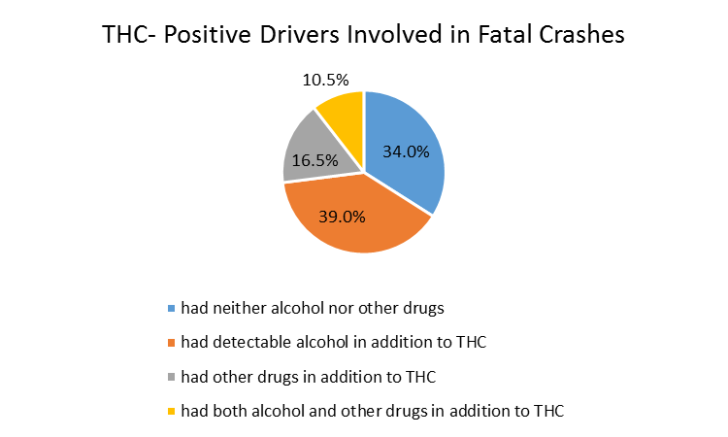
Key Findings
3,031 drivers involved in fatal crashes, estimated 10% positive for THC

Slide 9
Key Findings
THC is most prevalent for:
  Ages 18-34 (especially 18-20)
  Drivers with suspended/revoked license
  Drivers with detectable alcohol levels
  Drivers of older vehicles

Slide 10
Key Findings
From 2010 through 2013, the estimated number and proportion of drivers involved in fatal crashes who had a detectable concentration of THC in their blood ranged from a low of 48 (7.9%) to a high of 53 (8.5%)
  The number and proportion both doubled from 49 (8.3%) in 2013 to 106 (17.0%) in 2014

Slide 11
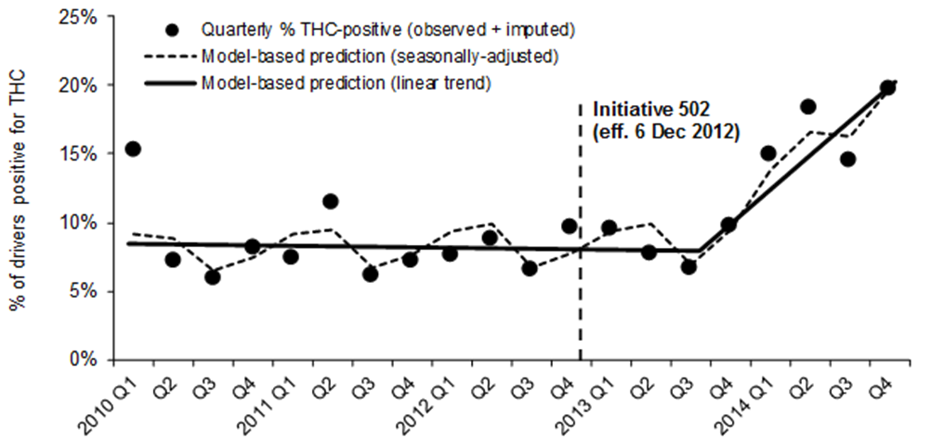
Key Findings
Figure 1. Quarterly average proportion of drivers involved in fatal crashes who were positive for THC and modeled seasonally-adjusted linear trend before and after Washington Initiative 502 took effect on 6 December 2012 legalizing recreational use of marijuana for adults aged 21 years and older, Washington, 2010 – 2014
Data: Washington Traffic Safety Commission, 2010 – 2014.
Drivers positive for THC based on results of blood toxicological tests. Results imputed 10 times when driver was not tested or test results were unknown; results reflect averages from 10 imputed values for each driver. Model-based predictions are from binomial regression model with identity link function, indicator variables for seasons, and a two-part linear spline with change in slope on 5 September 2013 (39 weeks after effective date of Initiative 502)

Slide 12
Key Findings
Analysis of trends over time before and after Initiative 502 took effect indicate that the proportion of drivers positive for THC was generally flat before Initiative 502, but began increasing significantly approximately 9 months after the effective date of Initiative 502

